Slide 1


WAD Project
e-commerce web-based
APPLICATION INTEGRATED
WITH MOMO PAYMENT
Presentation by
Project Group 3

Slide 2

Project Group 3
Introduction
our team has built an e-commerce platform with a variety of items such as clothes, shoes, and jewelry on the website platform in the form of payment in cash or electronic wallet momo.
1

Slide 3


Project Group 3
Our Team
Mai Huong-ITITIU19128
Thu Hoa-ITITIU19120
2

Slide 4

Project Group 3
Table Of Content
Overview
Applied tools, techniques, and frameworks
System analysis and design
Demo
3

Slide 5

Project Group 3
Overview
Quickly and easily make online payments via the Momo wallet
This makes it easy for our customers to control their spending.
=> Our goal is to build the most convenient website for our customers.
4

Slide 6

Project Group 3
Project objectives and scope
Project objectives
Manage product.
Manage order.
Manage category.
Manage account.
Project scope
Customers can enjoy easy shopping from anywhere.
5

Slide 7

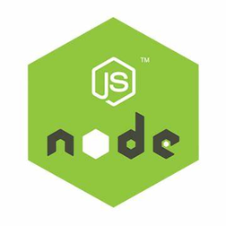
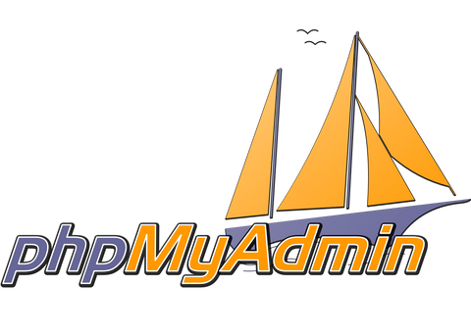
Project Group 3
Applied tools, techniques, and frameworks
Reactjs
Nodejs
MySQL
ReactJS is not a JavaScript framework. That’s because it’s only responsible for rendering the components of an application’s view layer.
Nodejs is an independent development platform
NodeJS can run on many different operating system platforms from Windows to Linux, and OS
The SQL phrase stands for Structured Query Language.
MySQL is the database management of the system or a database server.
6

Slide 8
Project Group 3
Core Features of React
Easily creating a dynamic web page.
Virtual DOM (Document Object Model)
Components and Props
State Management
Programmatic Navigation
=> The React Router package synchronizes the UI with the URL, giving control over the look of React applications without depending on links.
7

Slide 9
Project Group 3
Applied tools, techniques, and frameworks
Reactjs
Nodejs
MySQL
ReactJS is not a JavaScript framework. That’s because it’s only responsible for rendering the components of an application’s view layer.
Nodejs is an independent development platform
NodeJS can run on many different operating system platforms from Windows to Linux, and OS
The SQL phrase stands for Structured Query Language.
MySQL is the database management of the system or a database server.
8

Slide 10
Project Group 3
NodeJS advantages
NodeJS does not need to wait for the API to return data.
NodeJS is a Platform, not a Framework.
NodeJS can run on multiple platforms including Windows, MacOS, and Linux.
NodeJS is considered a single-threaded server and cannot support multithreading.
Performance and processing speed are relatively high.
NodeJS can create, open, read, write, delete, and close files while they are on the server.
Build content for dynamic websites.
Perform data collection according to specific requirements.
Perform query, edit, delete, and add data in basic management systems such as Microsoft SQL Server, and MySQL.
9

Slide 11
Project Group 3
Applied tools, techniques, and frameworks
Reactjs
Nodejs
MySQL
ReactJS is not a JavaScript framework. That’s because it’s only responsible for rendering the components of an application’s view layer.
Nodejs is an independent development platform
NodeJS can run on many different operating system platforms from Windows to Linux, and OS
The SQL phrase stands for Structured Query Language.
MySQL is the database management of the system or a database server.
10

Slide 12
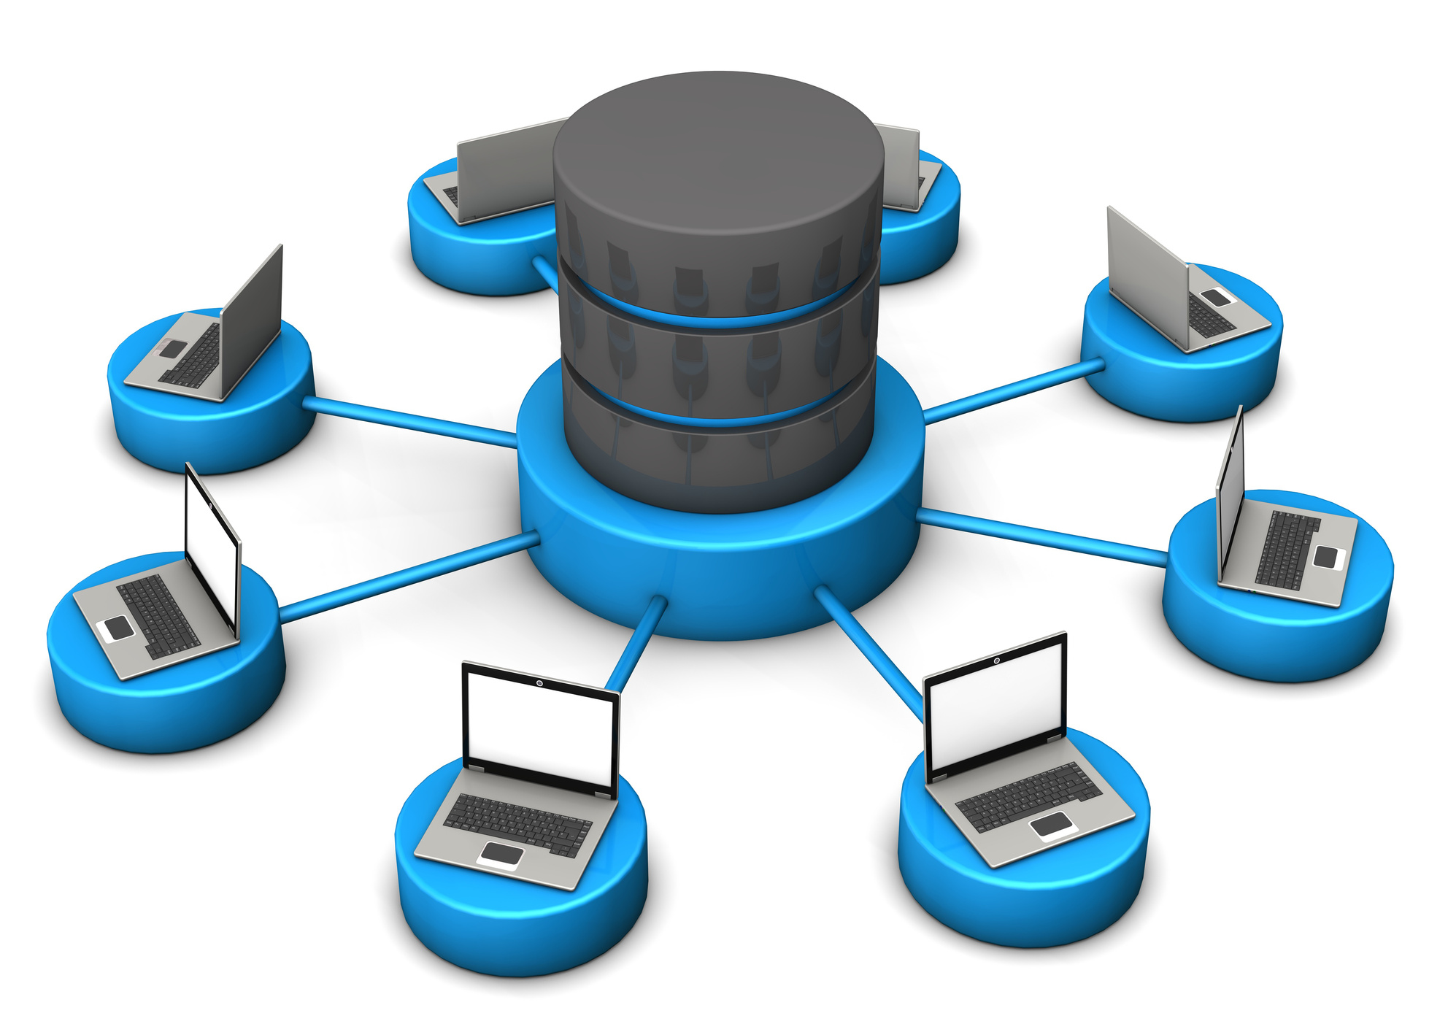
Project Group 3
phpMyAdmin
Browse and drop databases, tables, views, fields, and indexes.
Create, copy, drop, rename, and alter databases, tables, fields, and indexes.
Maintenance servers, databases, and tables, with proposals on server configuration.
Execute, edit, and bookmark any SQL statement, even batch queries.
Manage MySQL user accounts and privileges.
Manage stored procedures and triggers.
11

Slide 13
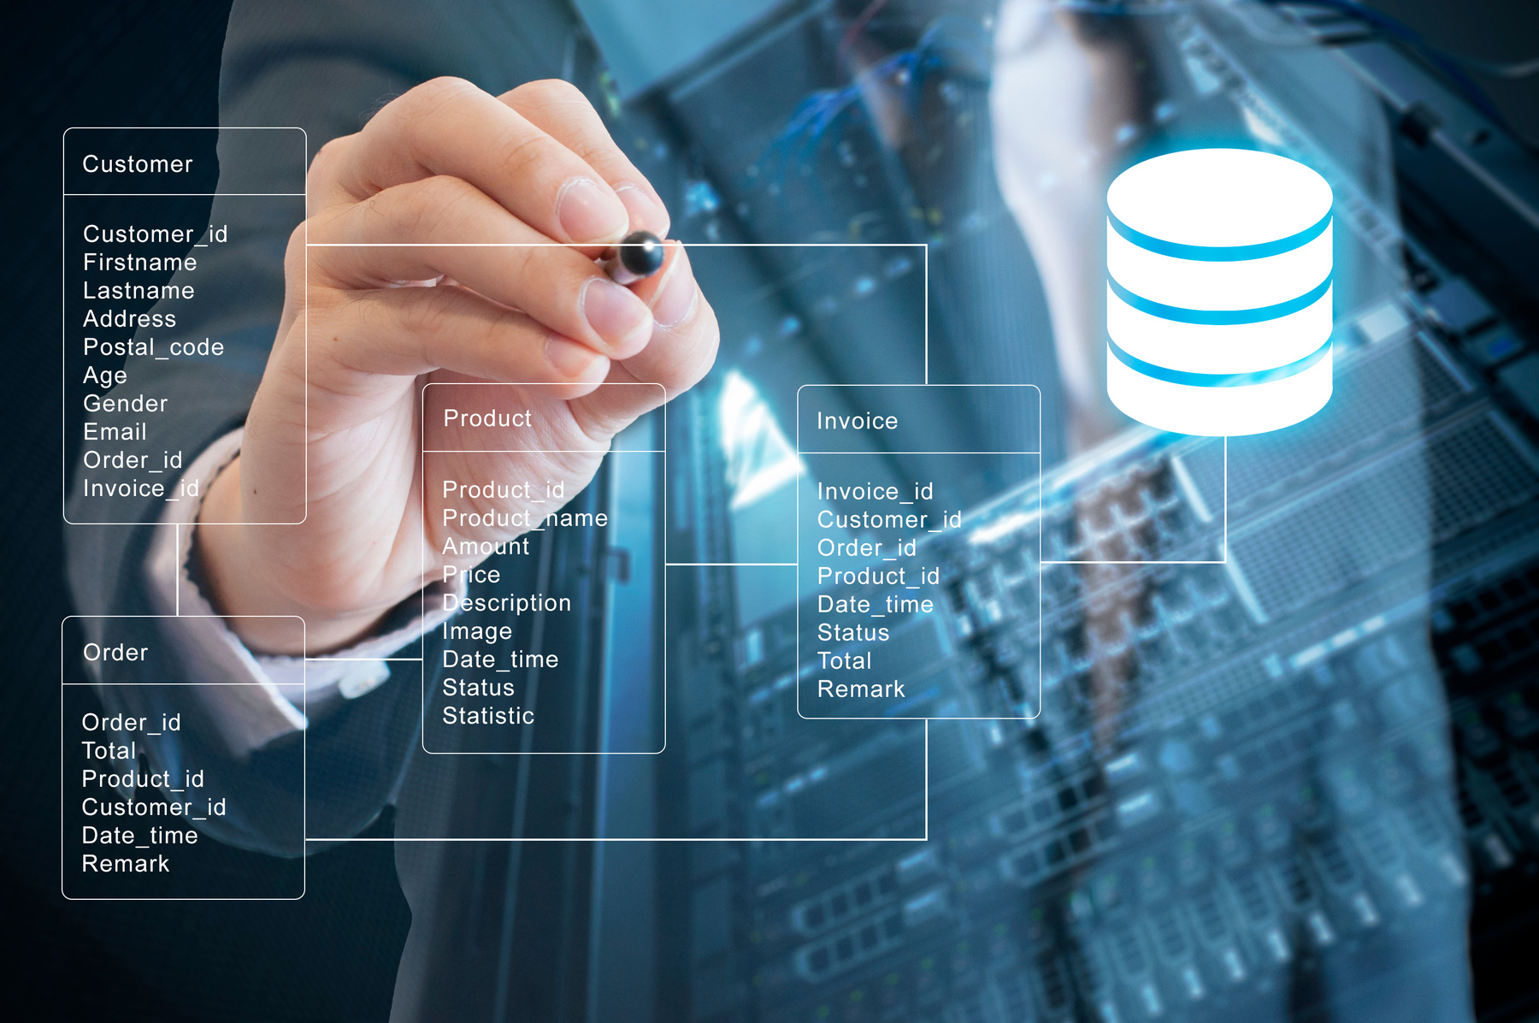
Project Group 3
System analysis and design
Limitations of traditional shopping
Our proposed system
System artifacts
12

Slide 14
Project Group 3
Limitations of traditional shopping
Geographical limitations and inconvenience
Impersonal customer service
and limited assistance
Less user-friendly in some cases and limited access to information
Inflexible shopping hours and peak period challenges
13

Slide 15

Project Group 3
Our proposed system
System functional requirements
System non-functional requirements
14

Slide 16
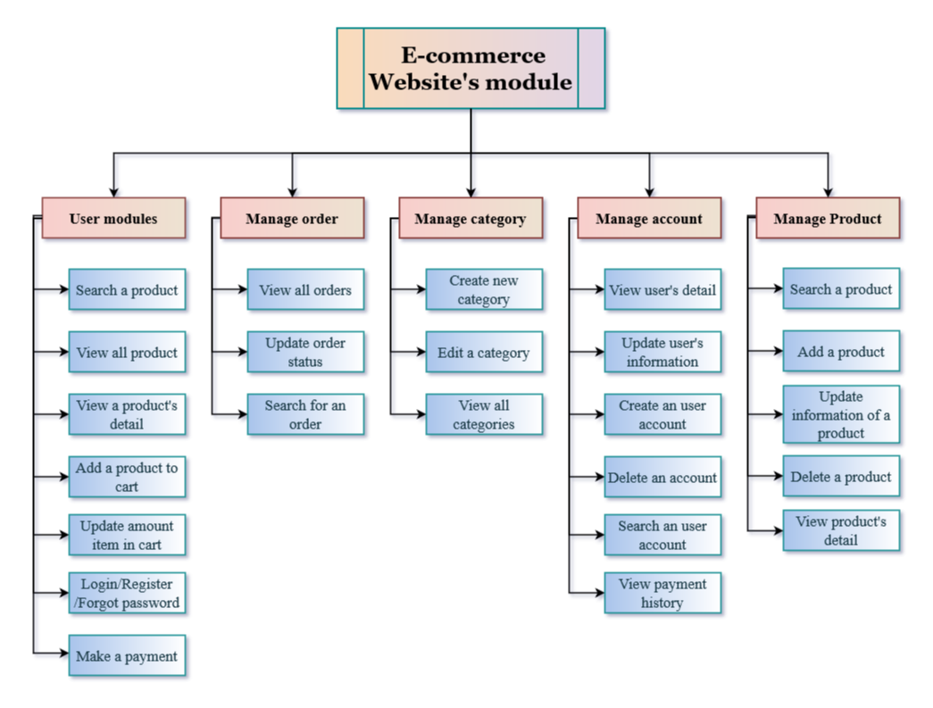
Project Group 3
System functional requirements
15

Slide 18

Project Group 3
System non-functional requirements
Efficiency
Dependable
Performance loading
Security
Reliable
Usable
Maintainability
16

Slide 19

Project Group 3
System artifacts
Use case diagram
Entity-Relationship Model diagram
Object-relational mapping diagram
17

Slide 20
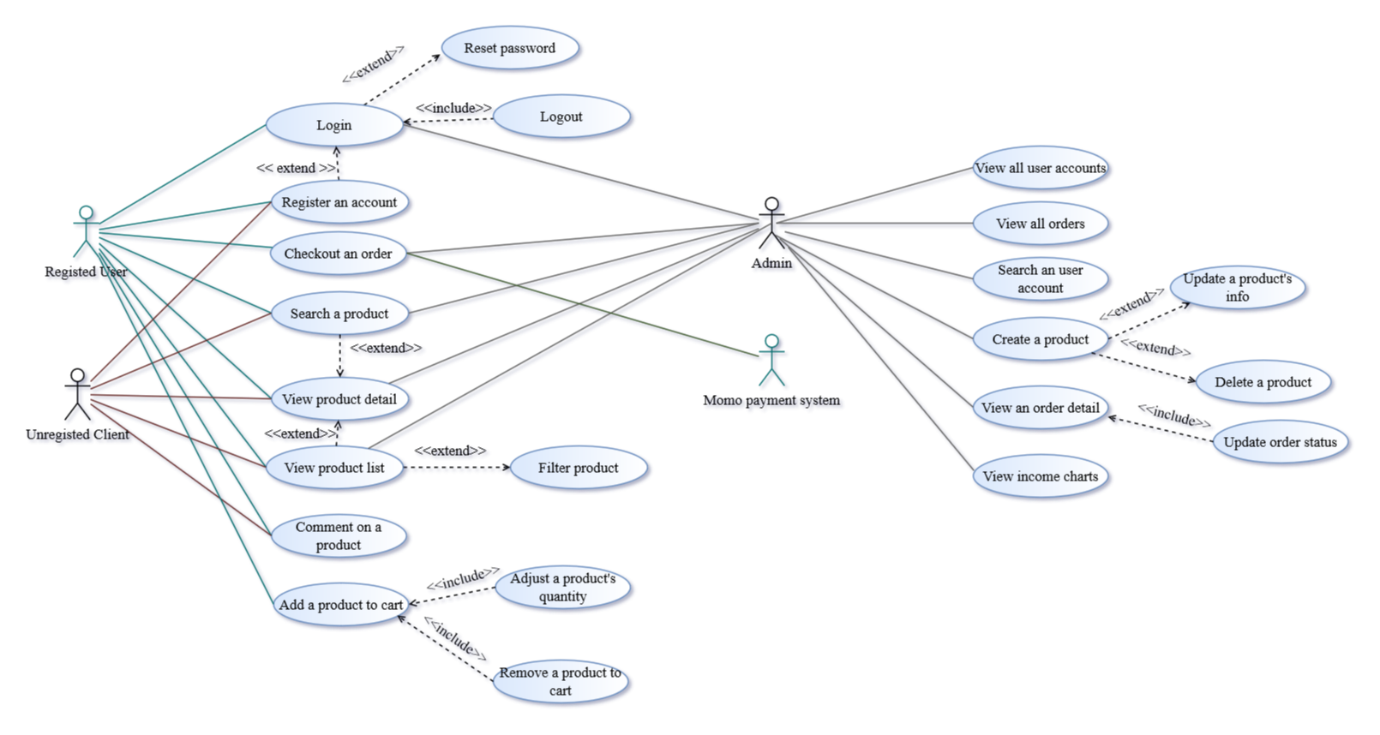
Project Group 3
Use case diagram
18

Slide 22
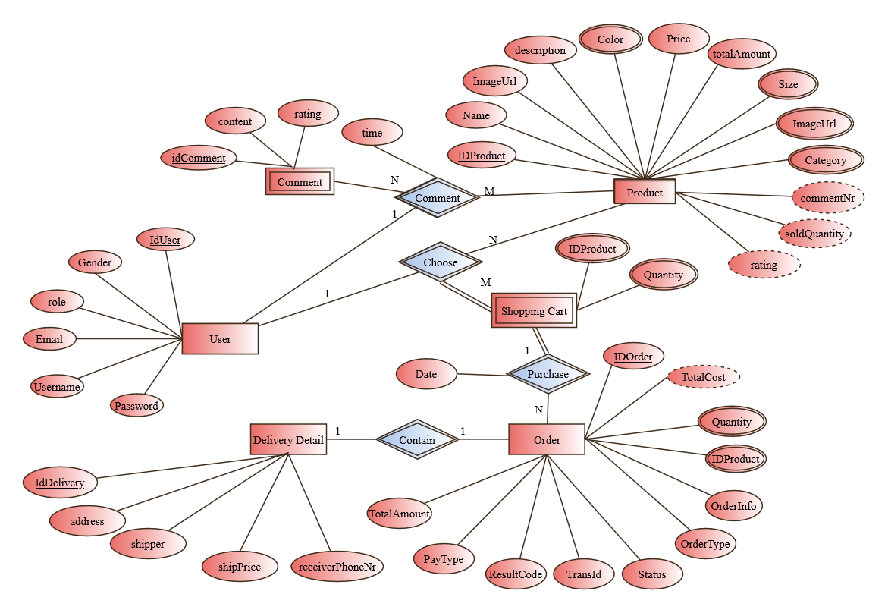
Project Group 3
Entity-Relationship Model diagram
19

Slide 24
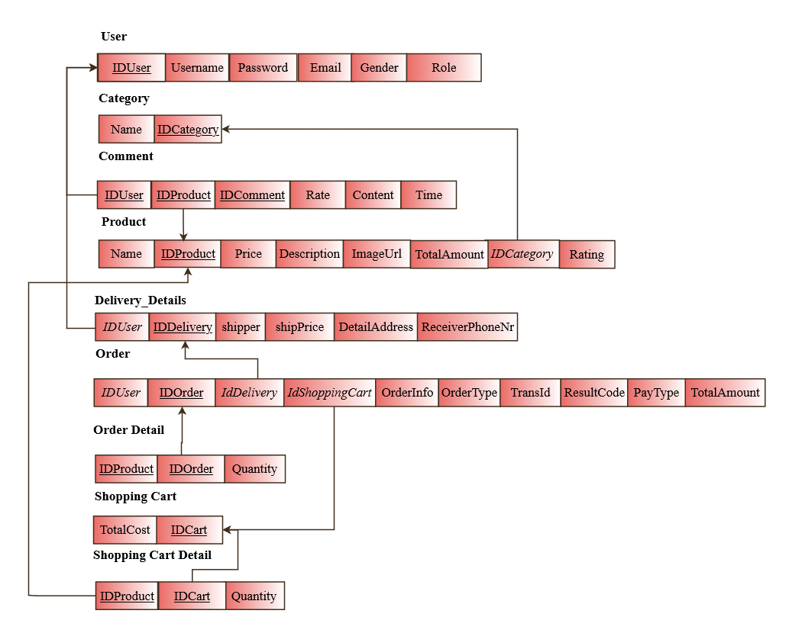
Project Group 3
Object-relational mapping diagram
20

Slide 26
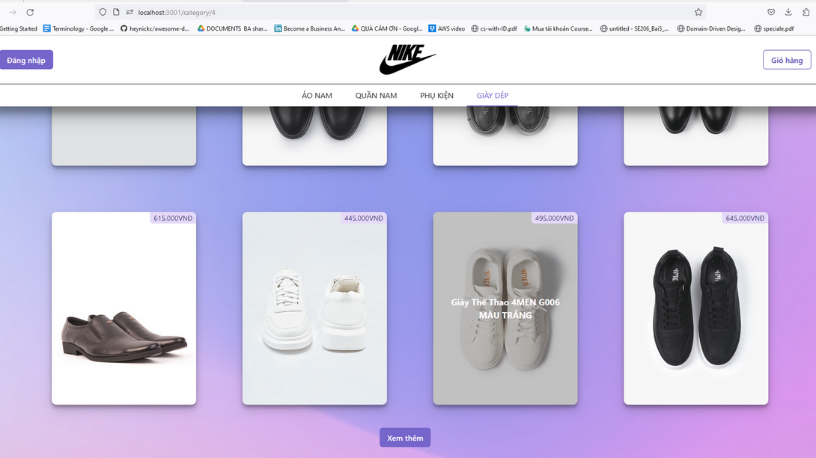
Project Group 3
Demo
21

Slide 27

Project Group 3
Question session
If you have any questions, you are welcome to ask now
Thank You

